Slide 1

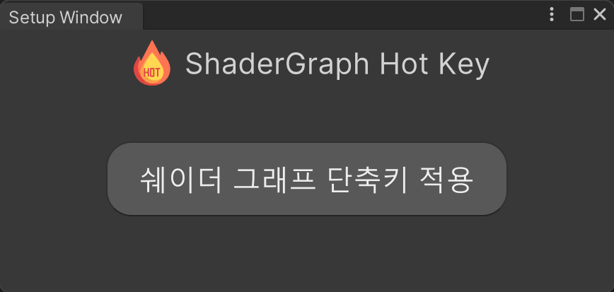
Shader Graph Hot Key
1.4.0 Lite
Amplify Shader Graph has shortcut keys, but Unity Shader Graph is not, so it is a plugin that was created.
How to install :
Prepare the state in which Shader Graph is installed.
At the top of Unity, click Windows -> ShadowGraph Hotkey -> Setup Window, and then click the corresponding button.
Installing :
During installation, Define is added, the function is activated, and 'Shortcut key application is complete' in the Setup Window. The patch is finally completed when the message pops up.

Slide 2
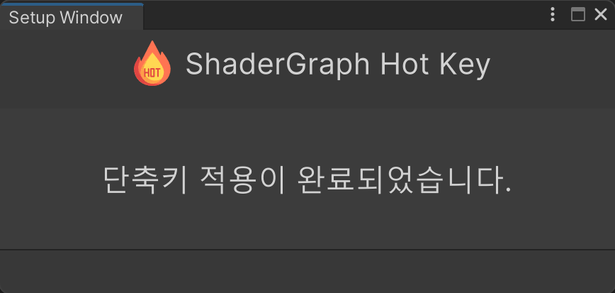
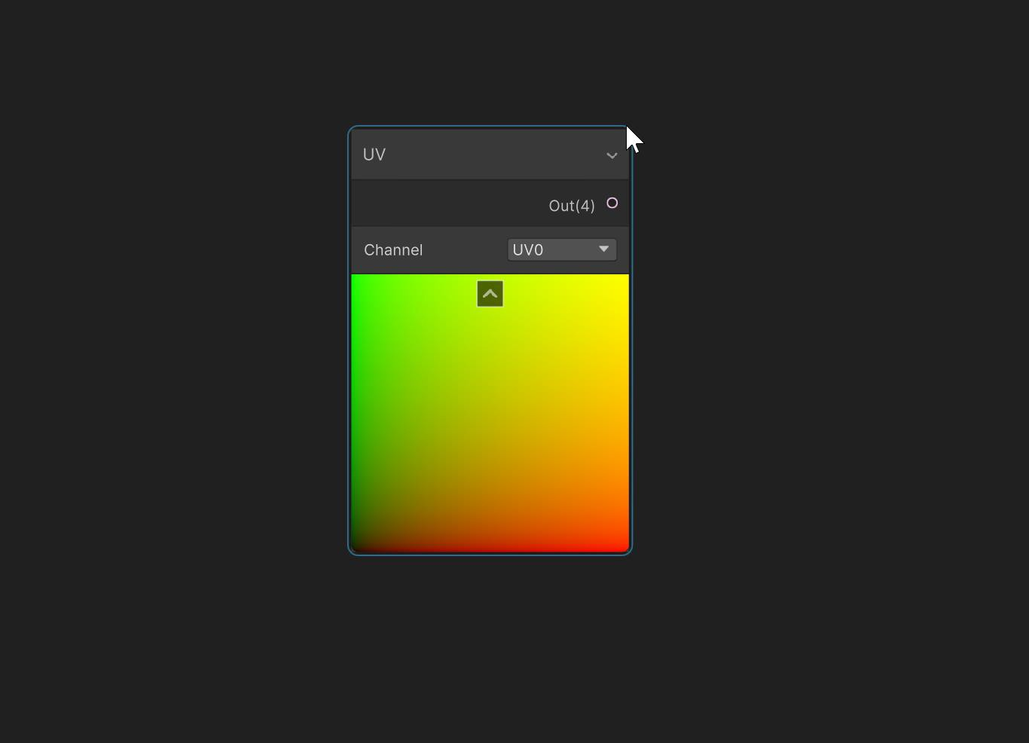
installed!
When the installation is complete, you will see the following message.
How to use :
Usage is the same as the Amplify shader shortcut system.
The shortcut for UV node is U, and while holding down the U key, If you click the left mouse button, a node will appear at the mouse cursor position.
is created.

Slide 3
Shortcut set
IntegerNode : | alpha 0
Vector1Node : | alpha 1
Vector2Node : | alpha 2
Vector3Node : | alpha 3
Vector4Node : | alpha 4
ColorNode : | alpha 5
SampleTexture2DNode : | T
UVNode : | U
AddNode : | V
SubtractNode : | S
MultiplyNode : | M
DivideNode : | D
OneMinusNode : | O
PowerNode : | E
LerpNode : | L
SplitNode : | B
SwizzleNode : | Z
NormalizeNode : | N
DotProductNode : | . (Dot)
Register Variable : | R
Get Variable : | G

Slide 4
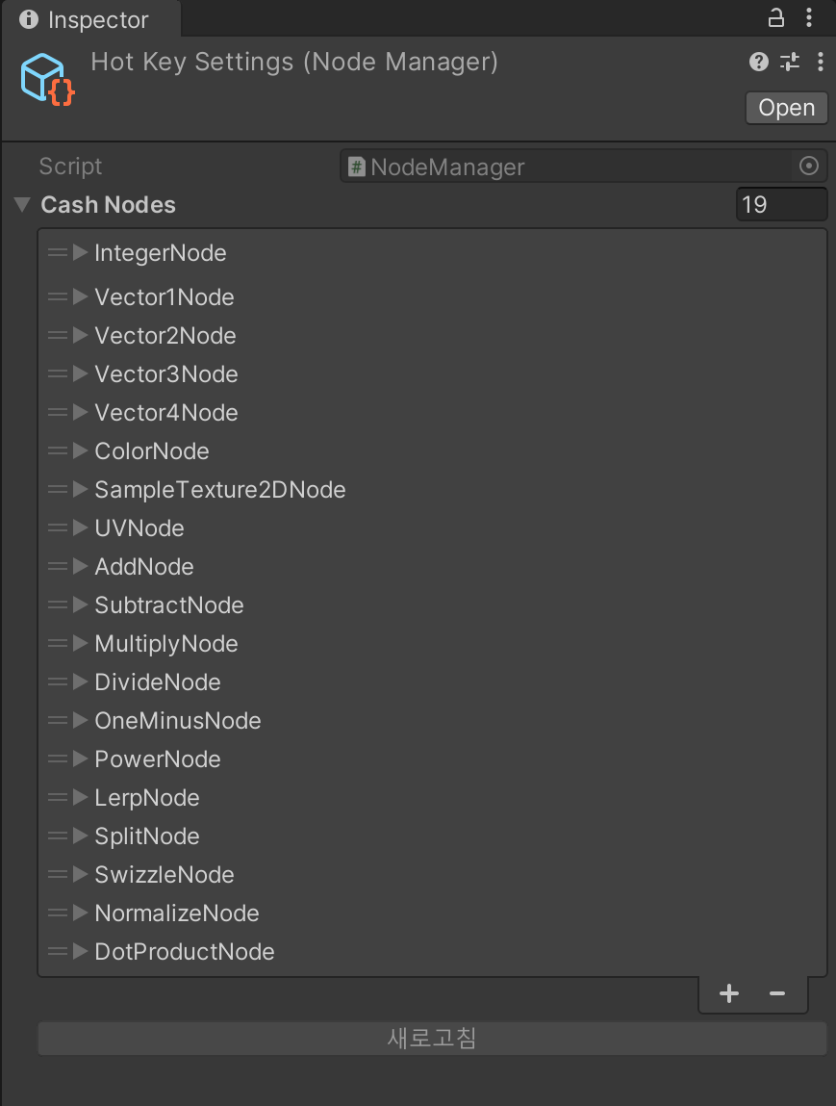
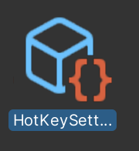

How to add shortcuts
Assets/Plugins/ShaderGraphHotKey/Settings/HotKeySettings.asset
If you go to the following path, you will find the HotKey Settings asset.
Click + to add a list.

Slide 5
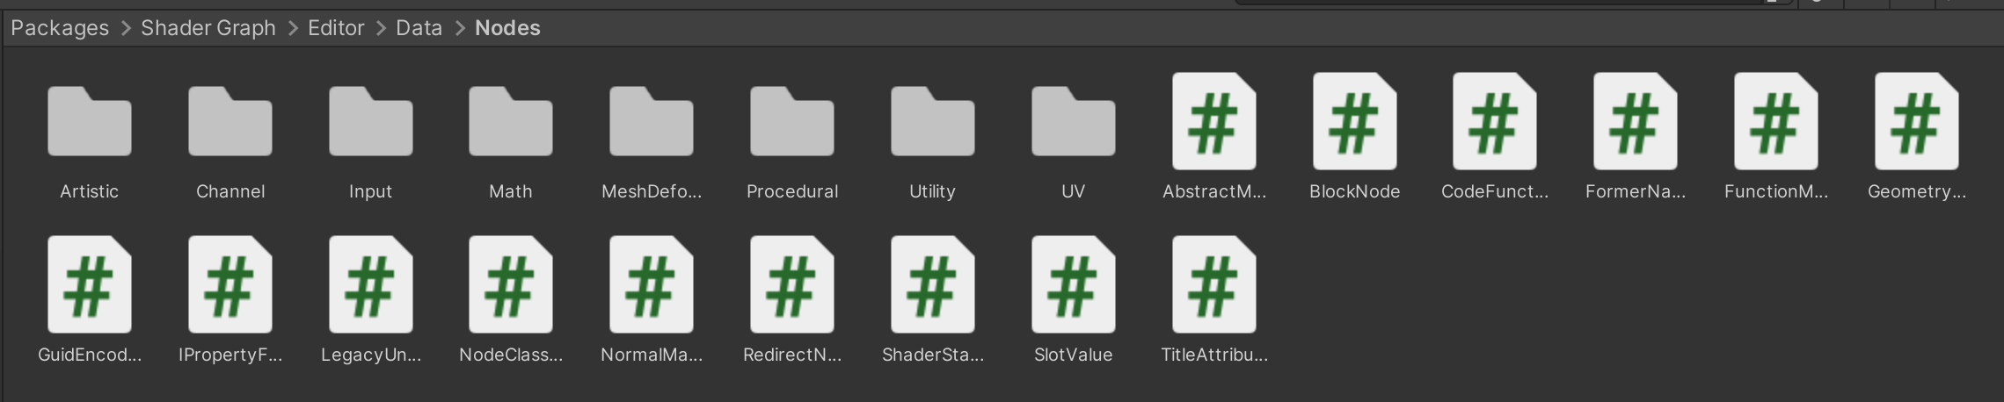
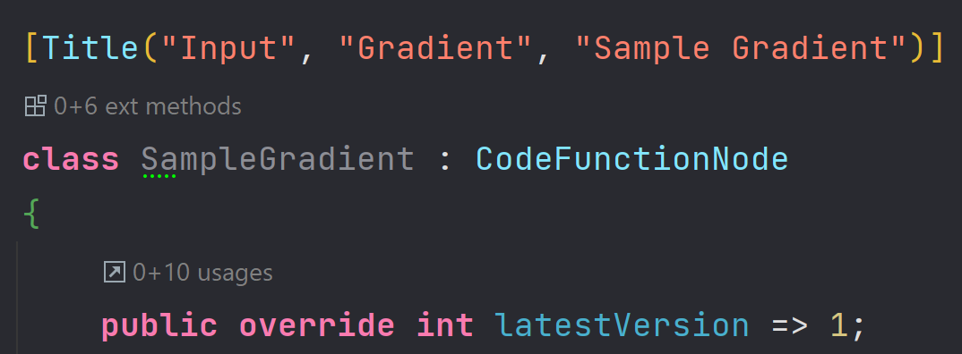
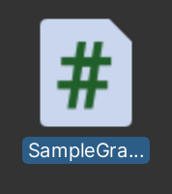
How to add shortcuts
Packages/com.unity.shadergraph/Editor/Data/Nodes
If you move from the package folder to the following path, you can see the nodes used in the shader graph.(It is recommended to use only what is in the folder)
copy
Assuming this node applies to shortcut keys,
copy the node's class name.
TMI : Sometimes, the C# file name and the class name are different, so be careful.

Slide 6
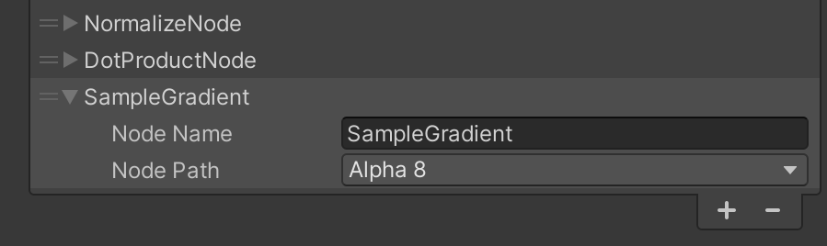
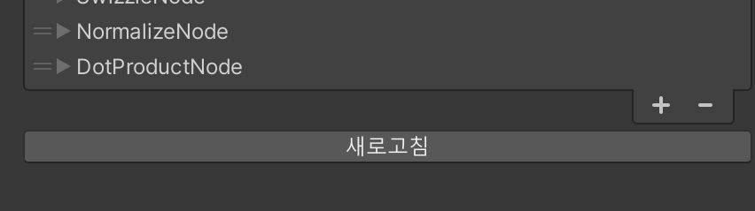
How to add shortcuts
Write the desired node (class) name in the settings file, and select the desired keystroke.
When the Refresh button becomes active, click it to finalize the application.
Caution!
If key input is duplicated with other nodes, it may not work, so be careful.

Slide 7
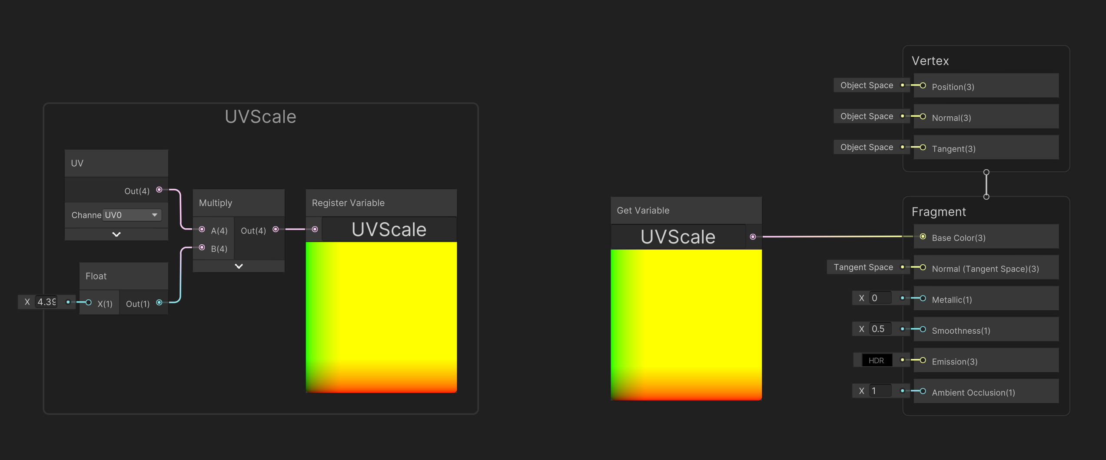
Register Variable Node & Get Variable
You can register a node and load it from a desired location.

Slide 8
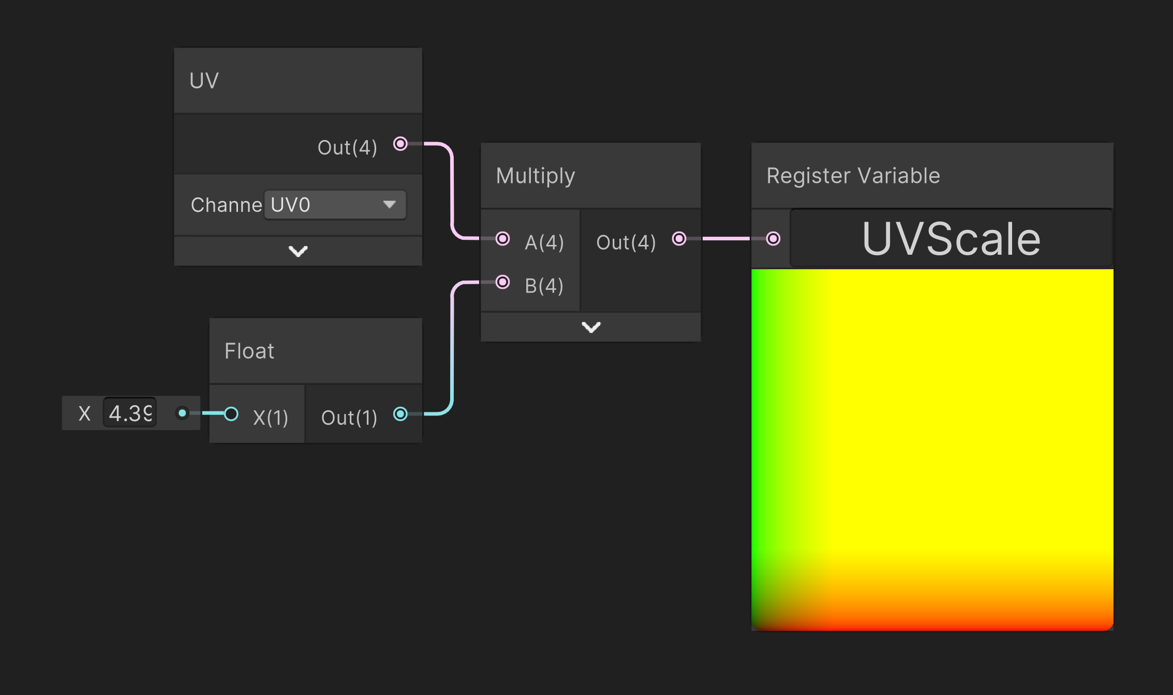
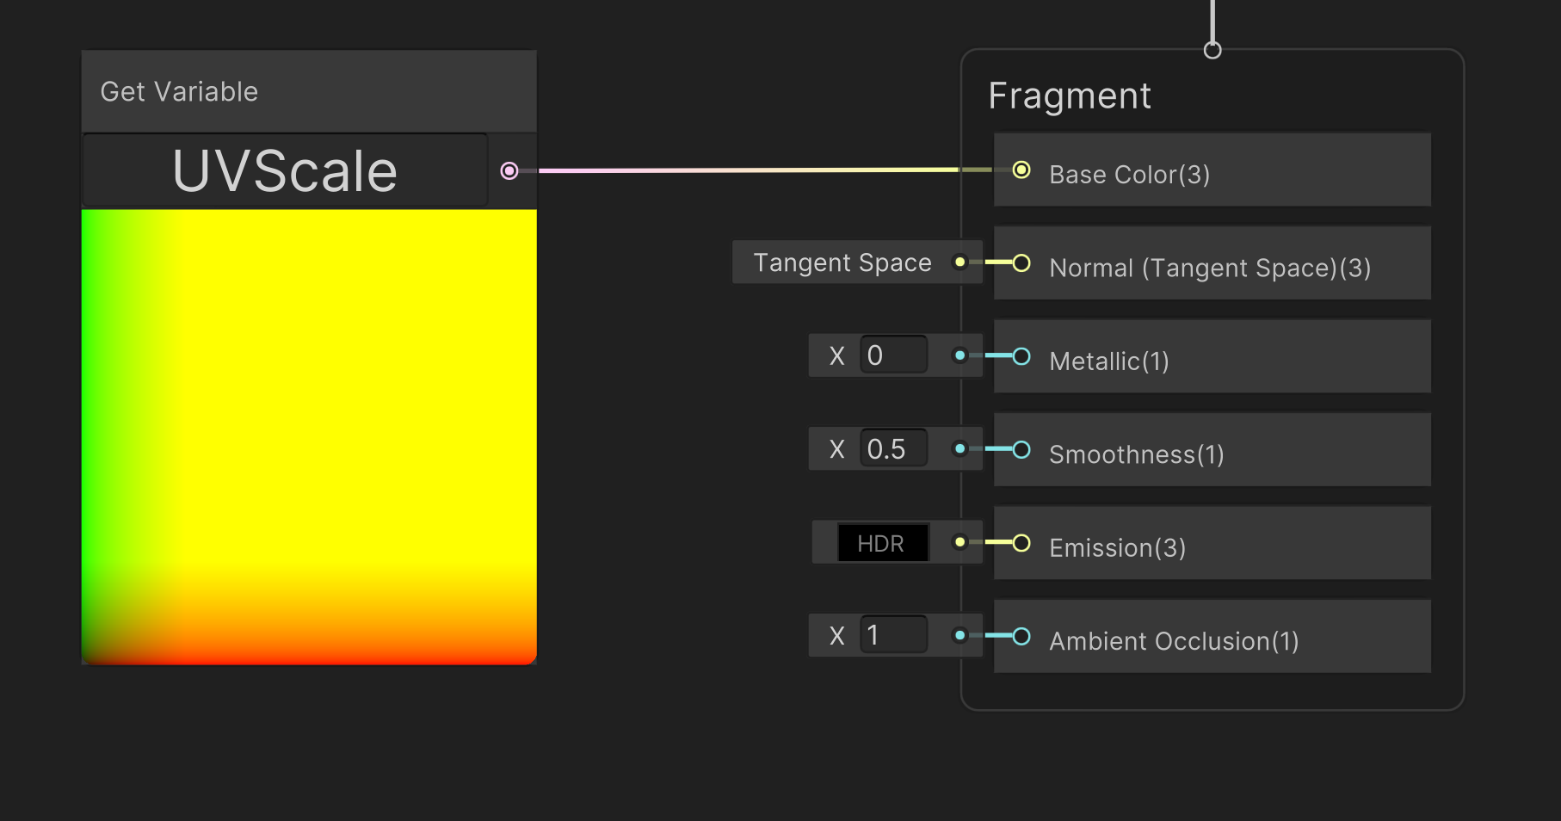
How to use
Write name
When you want to register the desired result value, Register Variable Just connect the nodes.
Only float1 and Vector4 are supported, and when Vector2 is connected, it is cast to Vector4.
When you want to use it, you can create a Get Variable node and call the node by writing the same name.

Slide 9
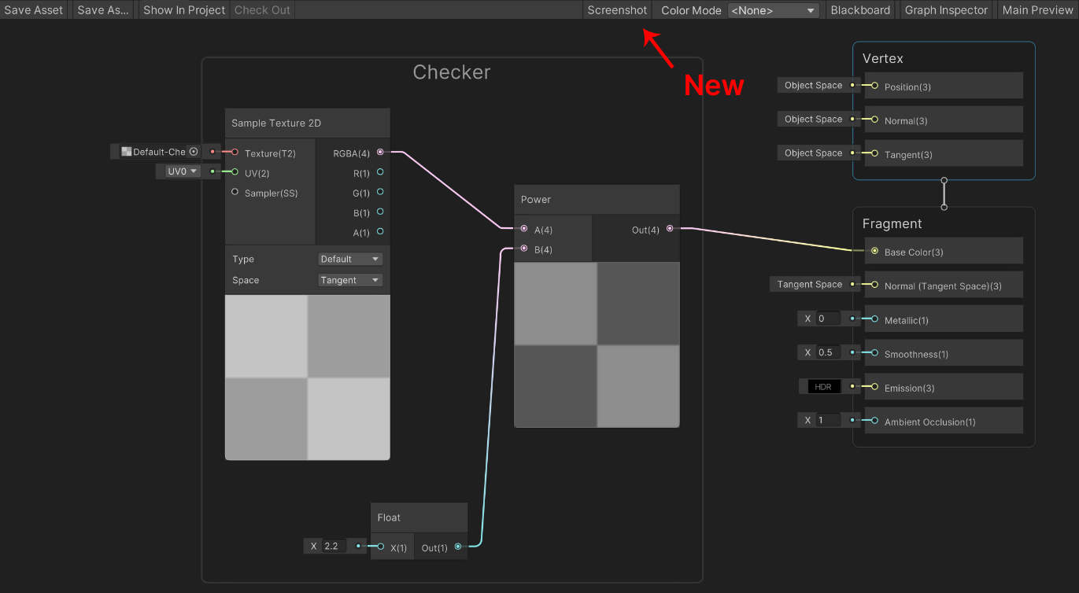
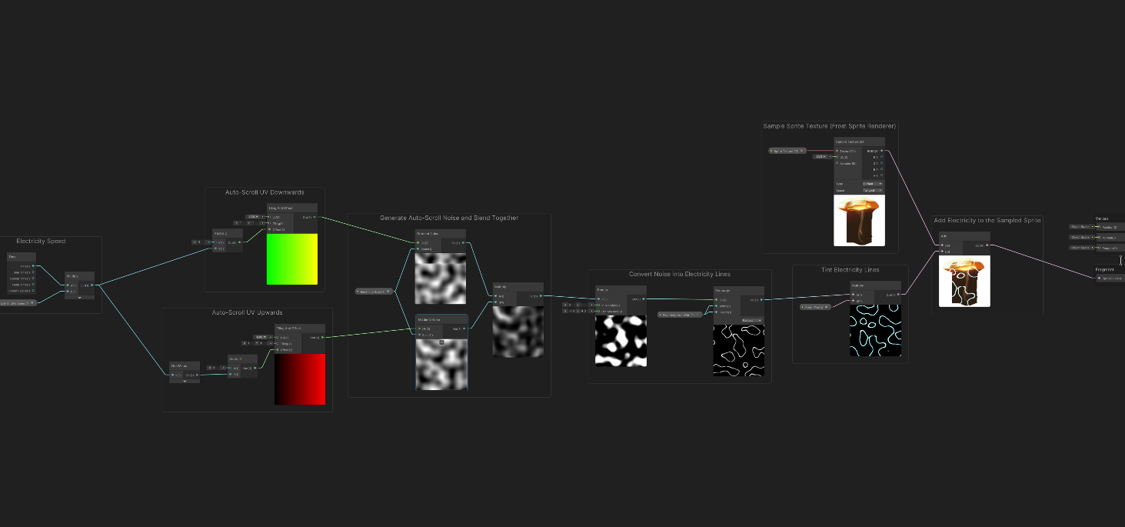
Screenshot System
You can capture a node with the screenshot function.
preview picture

Slide 10
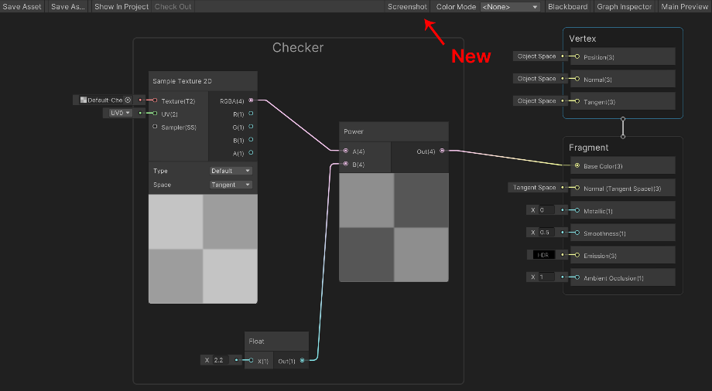
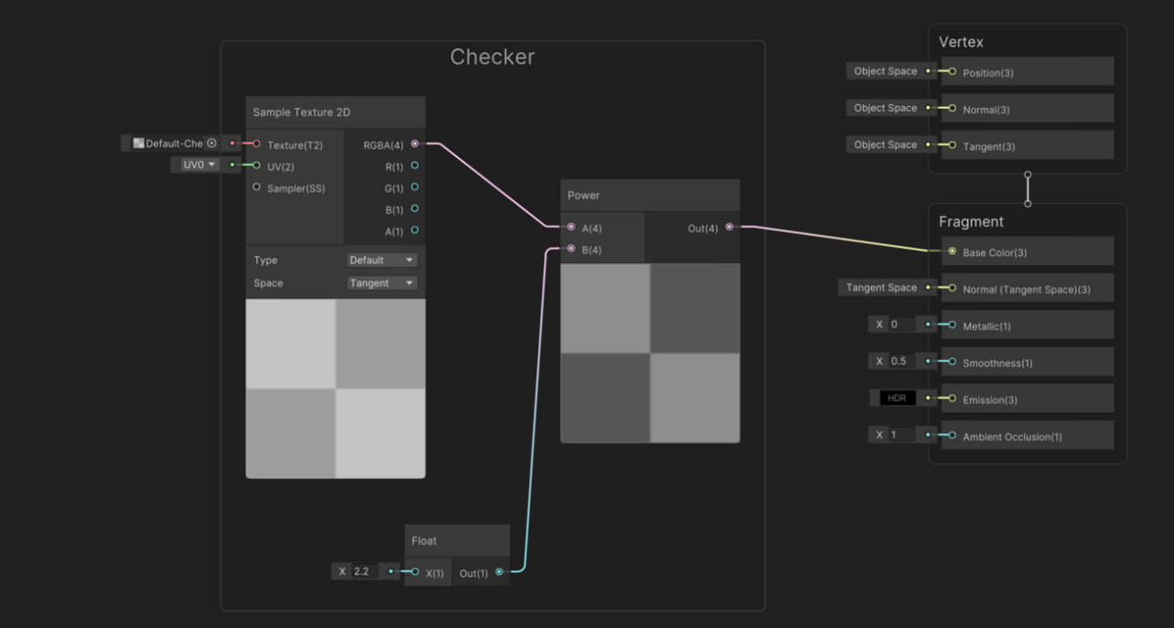
How to use
Click the screenshot button at the desired moment.
TMI :
When you click the button, the Graph Inspector/Main Preview/Blackboard is temporarily turned off.
When the action is done, you will get a Screenshot.png.
END!

